Slide 1
ALGORITHMS FOR MASSIVE DATA PROBLEMS
Supervised By:-
Dr. Benny George Kenkireth
Presented By:-
Devaishi Tiwari (170101021)

Slide 2
Objective
The objective of this thesis project is as follows,
Introducing the field of massive data analysis and communicate its usefulness in different sectors.
Discussing and implementing various existing algorithms related to massive data and evaluate their performance and correctness theoretically.

Slide 3
Big Data
According to Gartner, “Big Data are high volume, high velocity, or high-variety information assets that require new forms of processing to enable enhanced decision making, insight discovery, and process optimization.”
Big Data have certain characteristics that distinguish it from regular data. These are called the 8V's of Big Data, namely volume, velocity, variety, value, visualization, validity, veracity and variability

Slide 4

Applications
Banking and Security:
Predicting stocks' and shares' prices.
Monitoring the banks and trading markets for fraudulent practices.
Healthcare:
Finding out early-stage symptoms of various diseases.
Helping in efficient diagnosis of the patients.
Customer Behaviour Analysis:
Analyzing the customer’s choices and behaviour for growth.
Enhancing the customer experience.

Slide 5
Technique For Big Data Processing
Data Streaming
Data Sampling
Data Sketching

Slide 6
Data Streaming
Data Streaming involves generating a continuous array of data. In other words, the data items in a data stream arrive sequentially, instead of being stored inside the memory as a block.
Streaming data has turn out to be a central component of data architecture and analysis because of the sizeable increase in data from numerous non-conventional sources such as IoT Sensors, real-time advertising, service logs, telemetry from devices etc.

Slide 7
Sampling and Sketching
Data Sampling is generally defined as a rule-based process that selects a smaller set of items from a bigger group. Thus, in the data sampling model, the data is reduced into its much smaller approximation before being stored in the memory.
Data Sketching is essentially creation of a space-efficient report of the data which is useful for answering the given queries. This compact report/description, that contains all the relevant information about the data items, is called a sketch of the data.

Slide 8
DATA STREAMING

Slide 9
Advantages of Data Stream
Able to deal with never-ending sequence of events
Real-time or near-real-time processing
Able to detect patterns in massive datasets
Easy data scalability

Slide 10
Mathematical Representation
Suppose our data contains n data items, then we have a data stream of length n, {a₁, a₂, a₃, ...a_{n}} where a_{i} can take up any value from 1 to m = 2^{b}.
Storing the entire data generally would take O(n.b) space, but data streaming stores only one data element at a time and hence requires only O(b) space.
Another important terminology is the frequency of an element. Frequency of a symbol i, denoted by f_{i}, can be defined as the number of times that symbol occurs in the data stream.

Slide 11
Problems based on Data Stream
Approximating the count of distinct elements
Finding out the majority element
Finding out k most frequent algorithms

Slide 12
Distinct Element Count

Slide 13
Problem Definition and Naive Solution
Let us assume that we have a data stream of length n, {a₁, a₂, a₃, ...a_{n} } where a_{i} can take up any value from 1 to m. We need to determine the number of unique/distinct elements present in the stream.
Some of the most intuitive approach will be as follows:
• Create a bit-vector to record which of the m symbols have occurred, in the stream, so far - O(m) space
• Maintain all the distinct elements in a single set – O(n.log₂(m)) space
Note that we need at least O(m) space for any deterministic algorithm to find out the count of distinct numbers

Slide 14
Intuition for a Non-Deterministic Approach
We can approximate the count using the minimum element in the stream. Let D be the set of distinct elements and Min be the minimum element present in D.
E(Min) = m/2 if |D| = 1
= m/3 if |D| = 2
= m/(|D| + 1) .
Thus, the approx value of the count of distinct elements will be |D| = m/Min - 1
We can also improve the accuracy by introducing more randomization using a hash mapping over the data stream.
Notes:
Not suitable for skewed datasets, min is an outlier.

Slide 15
Flajolet Martin Algorithm
In Flajolet Martin Algorithm, we exploit the intuition that if the hash function generated an integer ending in 0^{m} bits (and it also generated integers ending in 0^{m−1} bits, 0^{m−2} bits, ..., 0¹ bits), the number of unique strings is around 2^{m}.
If we had a good, random hash function that acted on strings and generated integers, what can we say about the generated integers? Since they are random themselves, we would expect:
1/2 of them to have their binary representation end in 0 (i.e. divisible by 2),
1/4 of them to have their binary representation end in 00 (i.e. divisible by 4)
and in general, 1/2^{n} of them to have their binary representation end in 0^{n}

Slide 16
Flajolet Martin Algorithm
Method:
Create a bit vector of sufficient length L, such that 2^{L}>n (usually a 64-bit vector is sufficient). The i-th bit in this vector represents if we have seen a hash value whose binary representation ends in 0^{i}.
Generate a good, random hash function that maps input to natural numbers. For each word, hash it and determine the number of trailing zeros. Update the bit vector accordingly.
Once input is exhausted, get the index of the first 0 in the bit array (call this R). Calculate the number of unique words as 2R/ϕ, where ϕ is 0.77351.

Slide 17
Correctness and Complexity
The standard deviation of R is a constant: σ (R)=1.12. This implies that our count can be off by a factor of 2 for 32% of the observations, off by a factory of 4 for 5% of the observations, off by a factor of 8 for 0.3% of the observations and so on.
Assuming our stream contains n elements with m unique elements, the Flajolet Martin or FM algorithm runs in O(n) time. Note that the algorithm approximates the number of unique objects in a stream in one pass. The space complexity of this algorithm is O(log(m)).

Slide 18
Proposed Modification
It can be easily conclude that the accuracy of Flajolet Martin algorithm can be improved by using multiple hash functions over the stream and then taking the average of all the approximated counts corresponding to different functions.
Instead of taking average of all the values, use average of multiple buckets of counts and use their median to approximate count..
This leads to space consumption of O(log_{1+𝛄}n), for a small value 𝛄 greater than 0, in place of O(log₂n), in exchange of higher probability.

Slide 19
Majority Element

Slide 20
Problem Definition and Naive approach
A majority element is an element that occurs more than n/2 times in the stream. Let us consider the example of an election. Suppose there are m candidates and n number of votes, coming in as a stream of integers {a₁, a₂, …. a_{n}} where a_{i} can take up any value from 1 to m.
Some of the most intuitive approach will be as follows,
Store the number of occurrences of each symbol - O(m.log₂n) space
Store all the distinct elements in a set, along with their frequency – O(n.log₂n) space

Slide 21
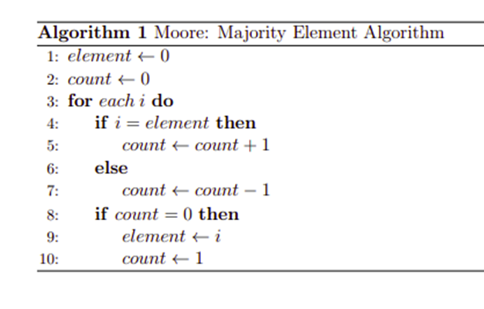
Moore Voting Algorithm

Slide 22
Correctness and Complexity
This deterministic algorithm returns the correct majority element, provided there is a majority element in the stream. In case the stream doesn't have a majority element, the algorithm can return any random element.
Thus, to ensure the correctness of the result, we can check whether the frequency of the returned element is greater than n/2 by going through the stream once more. (2nd pass)
The time complexity of the algorithm is O(n) - time required to parse the data stream twice. The space complexity is O(log m + log n) - space required to store the majority element and its count.

Slide 23
K Most-Frequent Elements

Slide 24
Problem Definition and Naive approach
Given a data stream, we need to approximate or find k most-frequent elements in the stream along with their corresponding frequencies.
Some of the most intuitive approach will be as follows,
Store the number of occurrences of each symbol and return k most-frequent symbols - O(m.log₂n) space
Store all the distinct elements in a set, along with their frequency and return k most-frequent symbols – O(n.log₂n) space

Slide 25
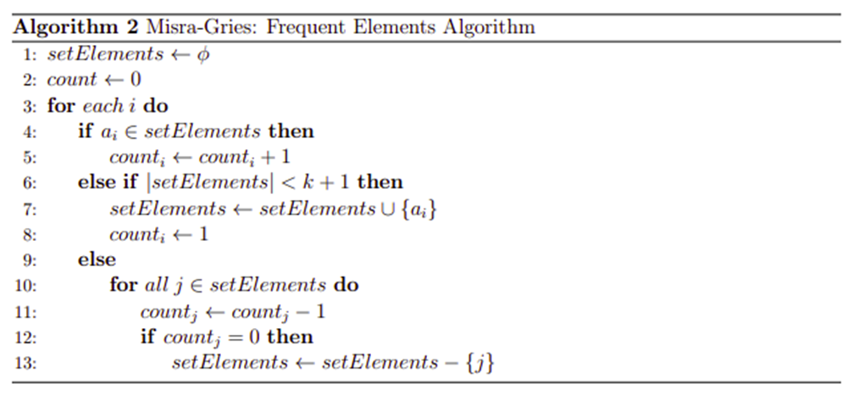
Misra Gries Algorithm

Slide 26
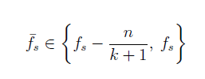
Correctness and Complexity
For each element s in the stream, the frequency calculated by the algorithm, fs’ is in the range,
where fs is the actual frequency of the element. Note that the frequency of all the elements, which weren't saved in the set, is considered as 0.
Similar to most data stream algorithms, the time complexity of the algorithm is O(n) - time required to parse the data stream once. The space complexity is O(k(log m + log n) - space required to store k most frequent elements and their counts.

Slide 27
Proposed Modification
Note that the range of the approximated frequency of an element is inversely proportional to the number of frequent elements required.
Thus, increasing the number of frequent elements will increase the accuracy of the frequencies of the corresponding elements by subsequently decreasing the range. Although it is important to note that this modification leads to more space consumption and hence is a space-accuracy tradeoff.
In my implementation, instead of storing count of k elements, 2k elements have been stored and k elements with most count/frequency are extracted.

Slide 28
Implementation and Results

Slide 29
Conclusion : Flajolet Martin Algorithm
The results are more accurate for larger-sized datasets, but the result within a constant factor of the original count for even for small-sized datasets.
Accuracy of the algorithm is significantly improved by using multiple hash functions and taking the median of their approximated counts. But this modification leads to more space consumption and hence is a space-accuracy tradeoff.

Slide 30
Conclusion: Misra Gries Algorithm
The algorithm provides close to accurate results. The algorithm may however provide inaccurate results if frequencies of different elements is very close/identical.
The returned frequencies of elements are in a close range of their original frequencies. This range gradually decreases if the required number of frequent elements increase.
Thus our modification of taking twice the number of frequent elements decreases the error range to almost half of the previous values, hence increasing the accuracy of the result.

Slide 31
Proposed Direction
There are various directions that can be pursued to increase the efficiency and accuracy of these algorithms. Some of these are,
A certain degree of parallelism can be introduced by processing records in small-sized batches, instead of processing them one by one.
The algorithm can also be extended to an framework, involving data stream ingestion, processing and data visualization etc. In future, these points can be taken into account.

Slide 32
Thank You

